Slide 1
Transient Fault Detection and Recovery Mechanisms in μC/OS-II
Chengrui He, Li Zhang, Gang Wang, Ziqi Zhen, Lei Wang
Beihang University

Slide 2
Transient Fault
Transient fault could sometimes happen
bit reverse
Satellites
Hospitals
…

Slide 3
Existed Methods To Detect Transient Fault
Hardware-based solutions
detect most of the faults
higher cost, lower flexibility
Software-based solutions
the ECCA signature algorithm (Z.Alkhalifa et al.)
a pure software-based CFCSS algorithm (Nahmsuk Oh et al.)

Slide 4
We Put Forward ...
a coarse-grained error detection scheme based on function call relationships
detects illegal jump at runtime
recover from fault
Notes:
In general

Slide 5
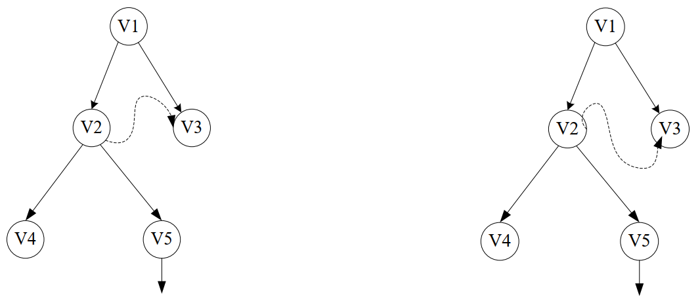
Types Of Illegal Jumps
Jump to a function entry
Jump into a function body

Slide 6
Our Fault Detection Scheme
Insert detection codes at compilation

Slide 7
Our Fault Detection Scheme
At the entry of every function
check if the calling is legal
get info of the caller dynamically
check whether the caller and the callee has the calling relationship
Jump to a function entry

Slide 8
Our Fault Detection Scheme
At the exit of every function
check if the function was entered from its entry point
mark at entrance with a flag
check if the mark exists at exit
Jump into a function body

Slide 9
More Details - Signature
Each function is assigned a unique signature attribute value Li
Each function is assigned a relationship attribute Si to record which function it might call
For each Li₁ of function 1 and Si₂ of function 2, exists an operator Op which makes Op(Li₁, Si₂) == true if and only if function 2 is a caller of function 1

Slide 10
More Details - Signature
void P() {
A();
B();
}
Li_{A} = 0001₂
Li_{B} = 0010₂
Li_{C} = 0100₂
Si_{P} = 0011₂

Slide 11
More Details - Entry
Sin = S;
Lin = L;
L = Li;
if (Li & Sin == 0)
error;
S = Si;
S, L – global variables used to deliver info from the caller
Li, Si – const local attributes mentioned before
Lin, Sin – local variables used to save info of the caller

Slide 12
More Details - Exit
Entry
Sin = S;
Lin = L;
L = Li;
if (Li & Sin == 0)
error;
S = Si;
Exit
if (Li != L)
error;
S = Sin;
L = Lin;

Slide 13
Implementation
Get call graph
open source tools such as Codeviz
Insert detection code
use compilers such as GCC
generate & insert automatically

Slide 14
Recover From Fault
Easiest way – restart module
Better way – restart from checkpoint
when to save information
correct
recent
for the scheduling module, it could be before a schedule process

Slide 15
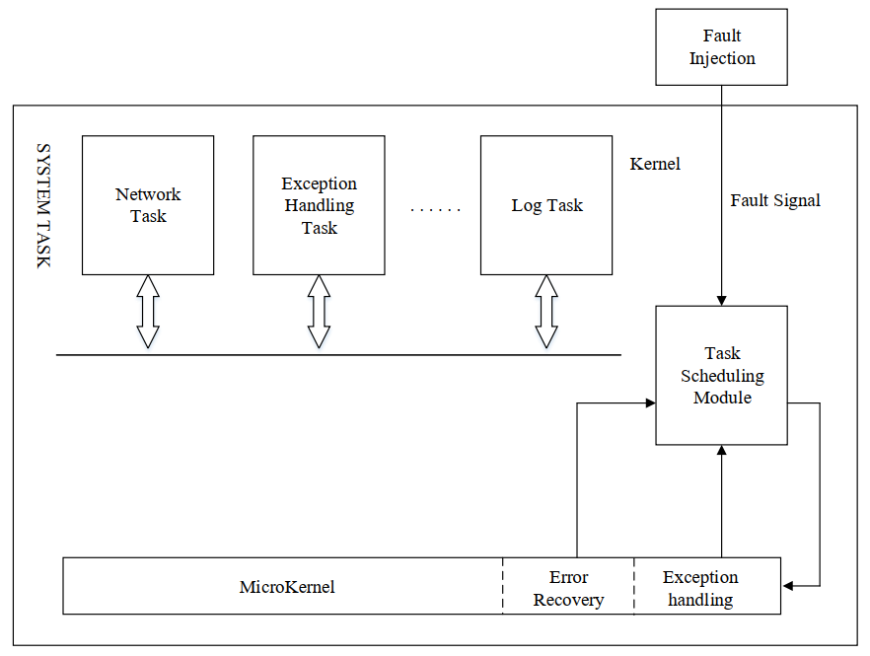
Testing

Slide 16
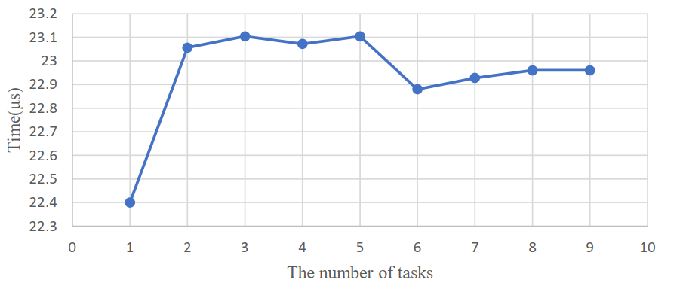
Testing
Light-weighted (size, speed)
Not sensitive to system load

Slide 17
Thank You

